Slide 1
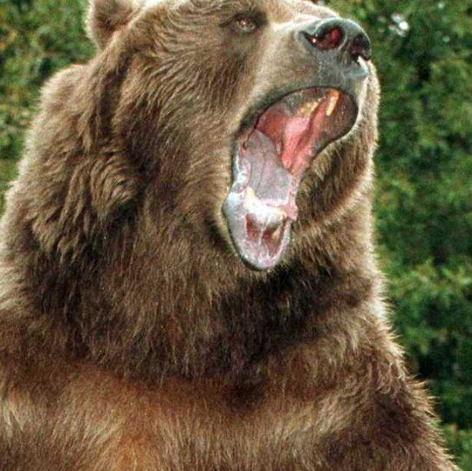

Poking the Bear:
Challenging the Status Quo
2025 Peer Support Conference
Strength in Equity & Diversity
Amplifying Voices, Ensuring Sustainability &
Building Stronger Peer Support Futures
Notes:
Open with smudging, prayer, land acknowledgement, whatever the group wants

Slide 2

Why do you do what you do?
What motivates you?

Slide 3


What’s the vision for your work/yourself?
Visioning
Finding partners/allies
Celebration

Slide 4

What hides behind the curtain?

Slide 5


Dealing with the challenges

Slide 6


How do you see things?

Slide 7

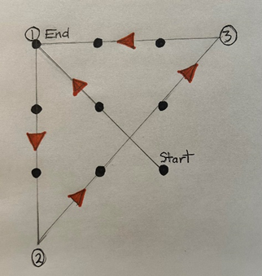
How do you see things?

Slide 8



Capability Building, Opportunities & Innovations

Slide 9


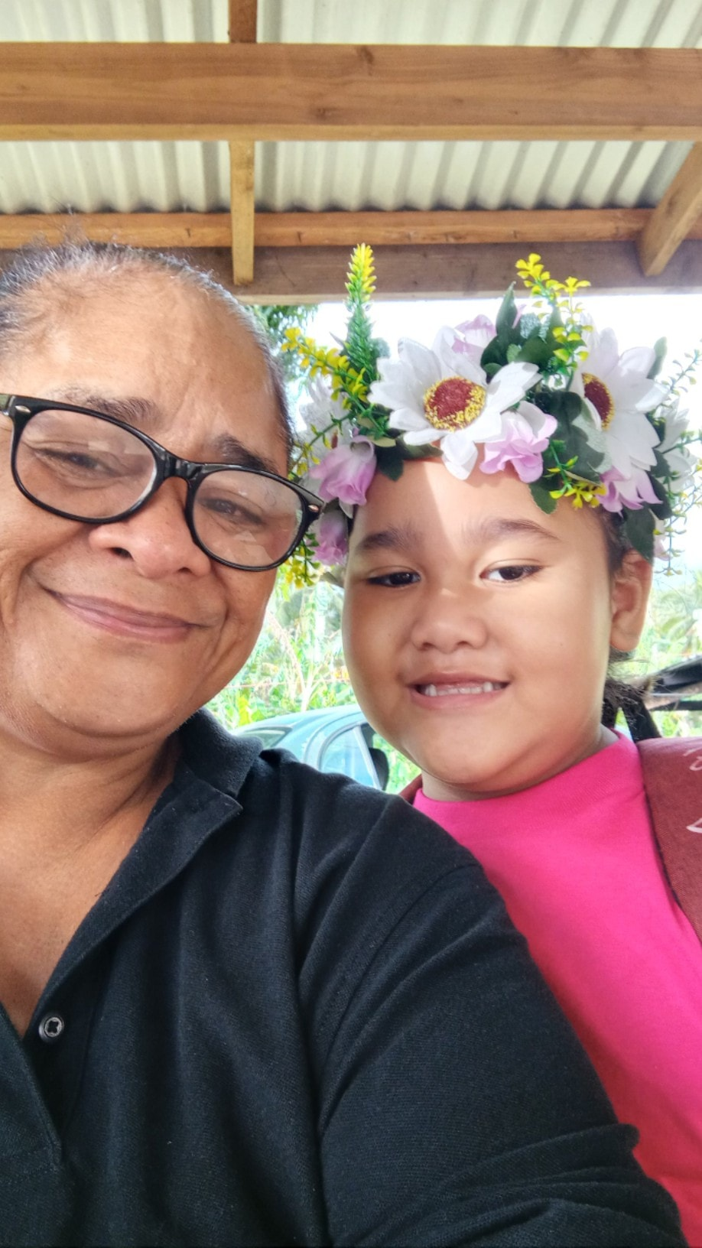
One Step at a Time

Slide 10
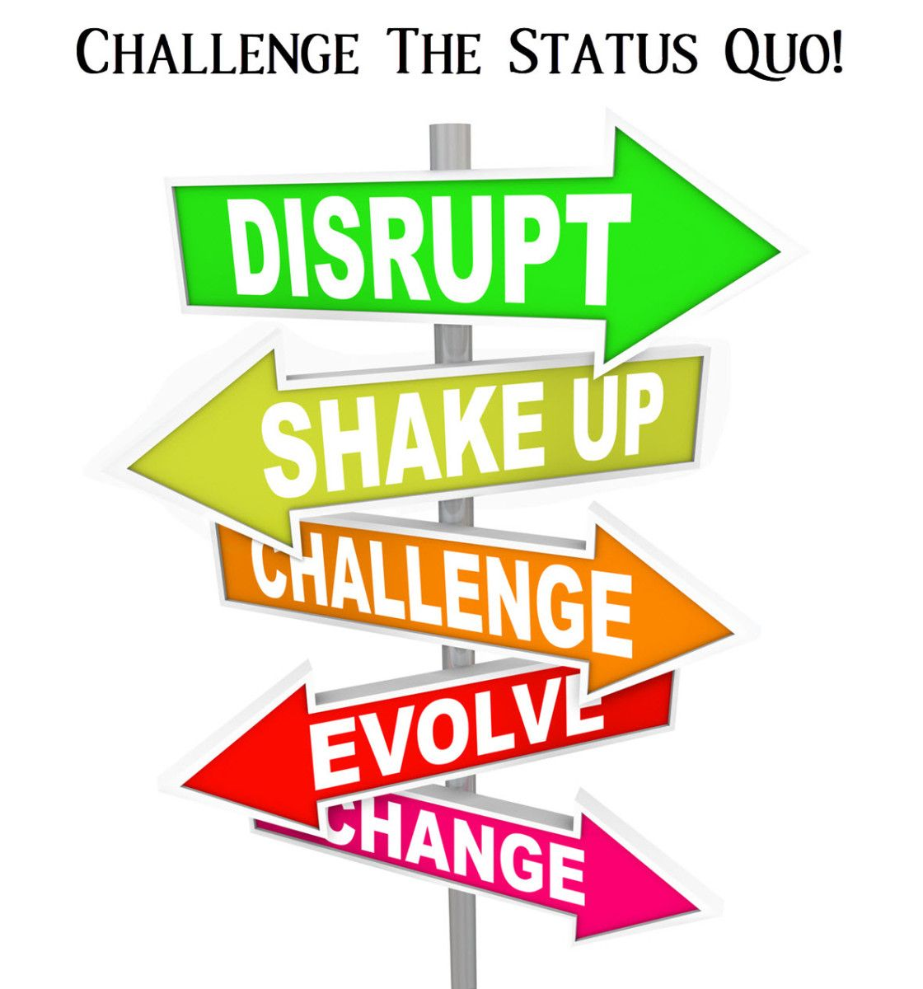
www.robynpriest.com www.explorationmastery.com robyn@robynpriest.com
Thank You

